Slide 1
Node.js
A JavaScript runtime built on Chrome’s V8 Engine
Notes:
Giới thiệu về khóa training
Các thành phần tham gia dự
Nội dung chính, lịch trình, tiêu chí và những quy định

Slide 2
Criteria & Regulations
Criteria:
1
2
3
4
5
Regulations:
1
2
3
4
5

Slide 3
Node.js – Training course
Section 2 – Day 1
How javascript works?
Trainer: kphong

Slide 4

SECTION 2 – MAIN CONTENT
INTRODUCTION ABOUT NODE.JS,
ARCHITECTURE, INSTALLATION AND USAGE
ENVIRONMENT
TERMS
EXECUTION CONTEXTS & SCOPE CHAIN
ECMASCRIPT
OVERVIEW
FEATURES & VERSIONS
FEATURES
LET & CONST
ARROW FUNCTIONS
Notes:
JavaScript thời kỳ trước sự có mặt của Node.js
Concepts, khái niệm cơ bản về Node.js
Kiến trúc tổng quan và một số chi tiết về Node.js
Cách cài đặt & sử dụng, quản lý phiên bản Node.js, quản lý gói/package/thư viện – dependencies và cách thực thi binaries của gói/package.

Slide 5

TERMS
ES6 module final syntax
For … of loop
Foreach
For… in
Difference foreach vs for in
Template Literals
Notes:
Phân tích cú pháp
Môi trường

Slide 6
ES6 module final syntax
http://2ality.com/2014/09/es6-modules-final.html
JavaScript does not have built-in support for modules, but the community has created impressive work-arounds. The two most important (and unfortunately incompatible) standards are
CommonJS Modules
Asynchronous Module Definition (AMD)

Slide 7
ES6 module final syntax
CommonJS Modules
The dominant implementation of this standard is in Node.js (Node.js modules have a few features that go beyond CommonJS). Characteristics:Compact syntax
Designed for synchronous loading
Main use: server

Slide 8
ES6 module final syntax
Asynchronous Module Definition (AMD)
The most popular implementation of this standard is RequireJS. Characteristics:Slightly more complicated syntax, enabling AMD to work without eval() (or a compilation step).
Designed for asynchronous loading
Main use: browsers

Slide 9
ES6 module final syntax
Asynchronous Module Definition (AMD)
The most popular implementation of this standard is RequireJS. Characteristics:Slightly more complicated syntax, enabling AMD to work without eval() (or a compilation step).
Designed for asynchronous loading
Main use: browsers

Slide 10
for…of
The for...of statement creates a loop iterating over iterable objects, including: built-in String, Array, Array-like objects (e.g., arguments or NodeList), TypedArray, Map, Set, and user-defined iterables. It invokes a custom iteration hook with statements to be executed for the value of each distinct property of the object.
https://developer.mozilla.org/en-US/docs/Web/JavaScript/Reference/Statements/for...of

Slide 11
for…in
A for...in loop only iterates over enumerable, non-Symbol properties. Objects created from built–in constructors like Array and Object have inherited non–enumerable properties from Object.prototype and String.prototype, such as String's indexOf() method or Object's toString() method. The loop will iterate over all enumerable properties of the object itself and those the object inherits from its constructor's prototype (properties closer to the object in the prototype chain override prototypes' properties).
https://developer.mozilla.org/en-US/docs/Web/JavaScript/Reference/Statements/for...in

Slide 12
for reach…in
https://developer.mozilla.org/en-US/docs/Web/JavaScript/Reference/Statements/for_each...in
The for each...in statement iterates a specified variable over all values of object's properties. For each distinct property, a specified statement is executed.

Slide 13
Difference foreach vs for in

Slide 14
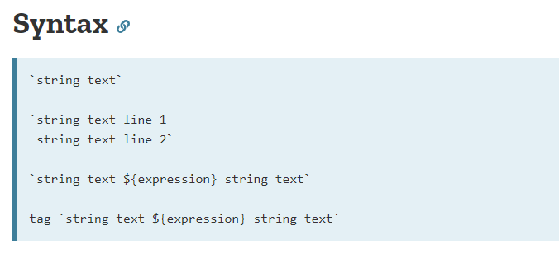
Template Literals(Template String)
https://developer.mozilla.org/en-US/docs/Web/JavaScript/Reference/Template_literals
Template literals are string literals allowing embedded expressions. You can use multi-line strings and string interpolation features with them. They were called "template strings" in prior editions of the ES2015 specification.

Slide 15
Thank you!

